Slide 1

TEAM Members :
SUSANTA KUMAR MOHAPATRA
SIBA PRASAD MAHARANA
SIBASNKAR SWAIN
ONLINE VOTING SYSTEM
GROUP NO - D12
Mentor: Sibo Prasad Patro

Slide 2
ABOUT THE PROJECT
“ONLINE VOTING SYSTEM” is an online voting technique. In this system people whose age is above 18 years of age and any gender can give his/her vote online without going to any physical polling station.it is an electronic way of choosing leaders via web driven application. The advantage of online voting over the common “queue method” is that the voters have the choice of voting at their own free time and there is reduce congestion.

Slide 3
OBJECTIVE:-
REVIEWING THE EXISTING/CURRENT VOTING SYSTEM.
COMING UP WITH AN AUTOMATED VOTING SYSTEM.
IMPLEMENTING A AN AUTOMATED VOTING SYSTEM.
VALIDATING THE SYSTEM TO ENSURE THAT ONLY ELIGIBLE VOTERS ARE ALLOWED TO VOTE.

Slide 4
COMPONENTS
SOFTWARE REQUIREMENT:-
OS-WINDOWS
XAMPP SERVER
VS CODE
HARDWARE REQUIREMENT:-
RAM-4GB
HARDDISK-40GB
PROCESSOR-INTEL CORE I3 CPU

Slide 5
DATA FLOWCHART.
START
HOME
ADMIN
USER
LOGIN PANEL
FEATURES
A
V
FEEDBACK

Slide 6
DATA FLOWCHART(CONT….)
A
ELECTION TYPE
CATEGORY LIST
USERS
ELECTION TYPE FORM
ADD
USER
EDIT
OR
DELEETE
ACTION
B

Slide 7
DATA FLOWCHART(CONT….)
V
VOTE
VIEW POLL
SUBMIT
LOGOUT
B

Slide 8
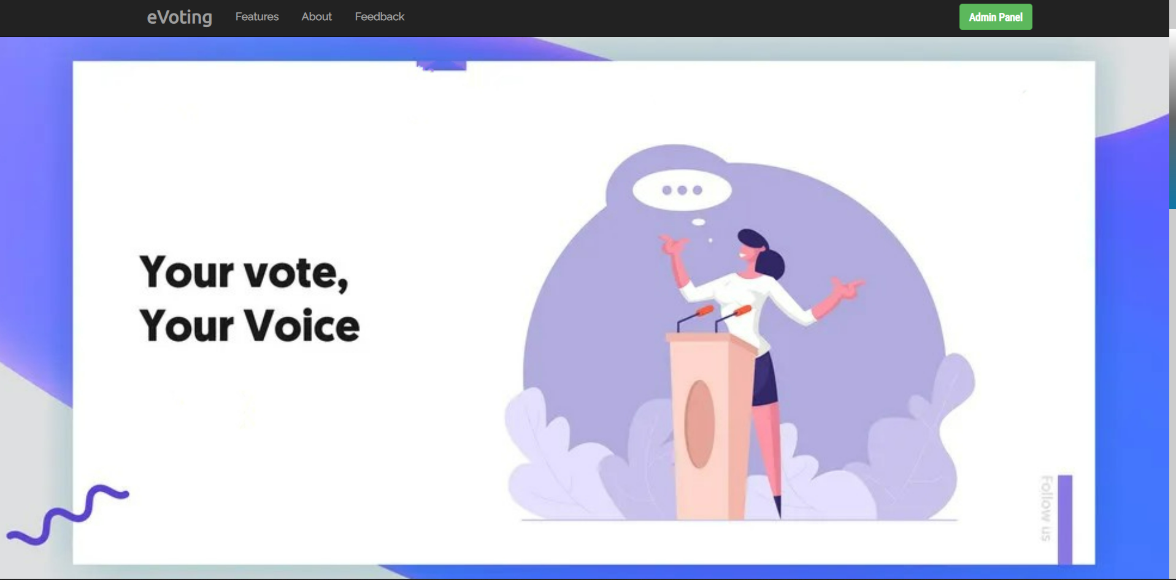
HOME PAGE

Slide 9
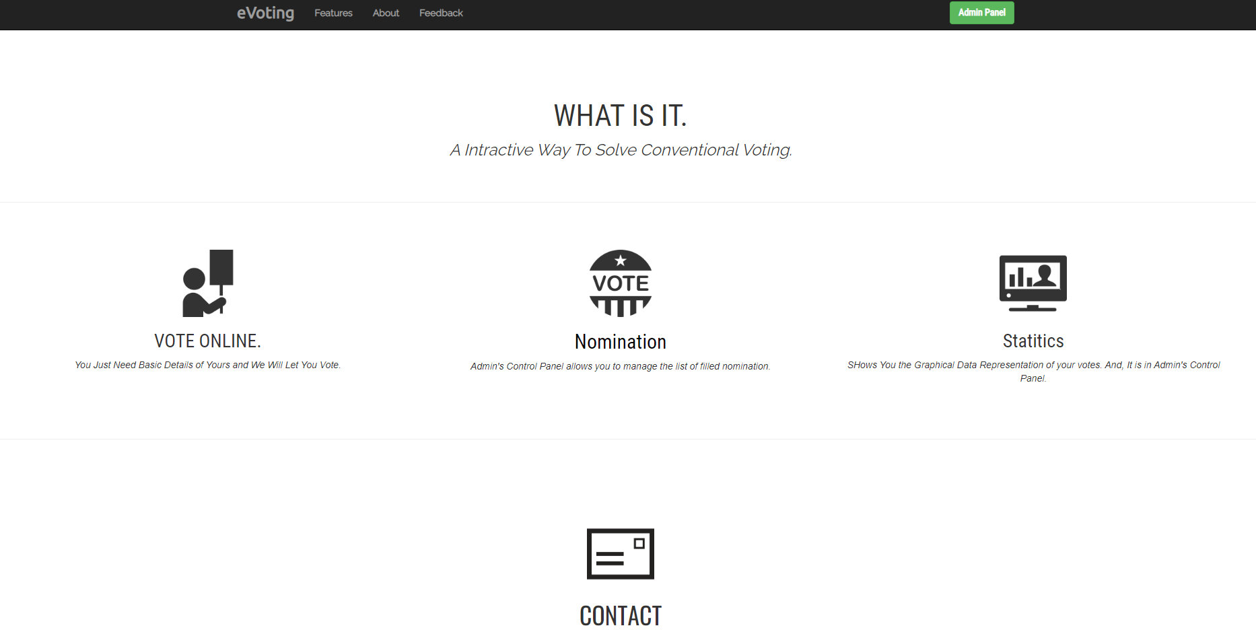
ABOUT PAGE

Slide 10
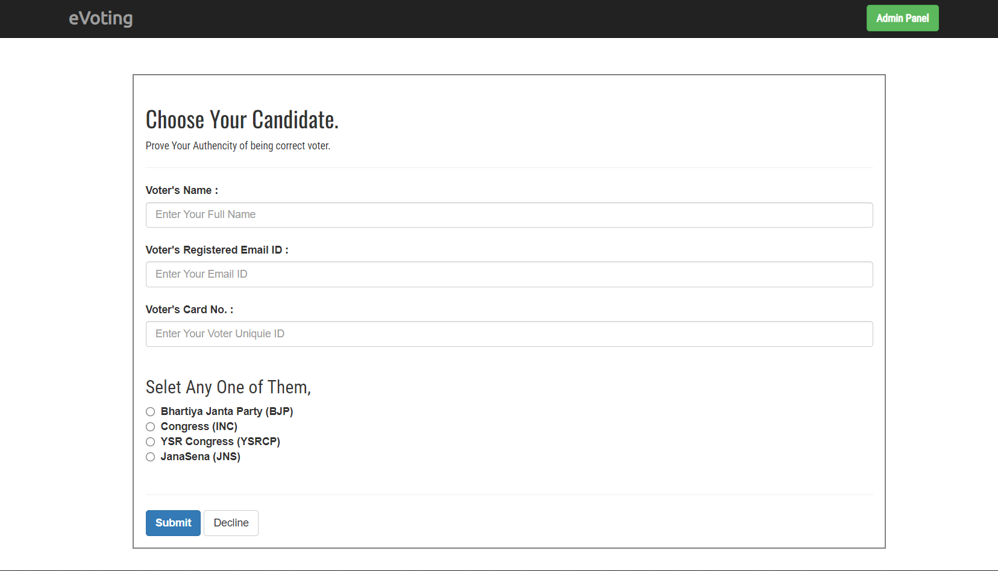
VOTING PAGE

Slide 11
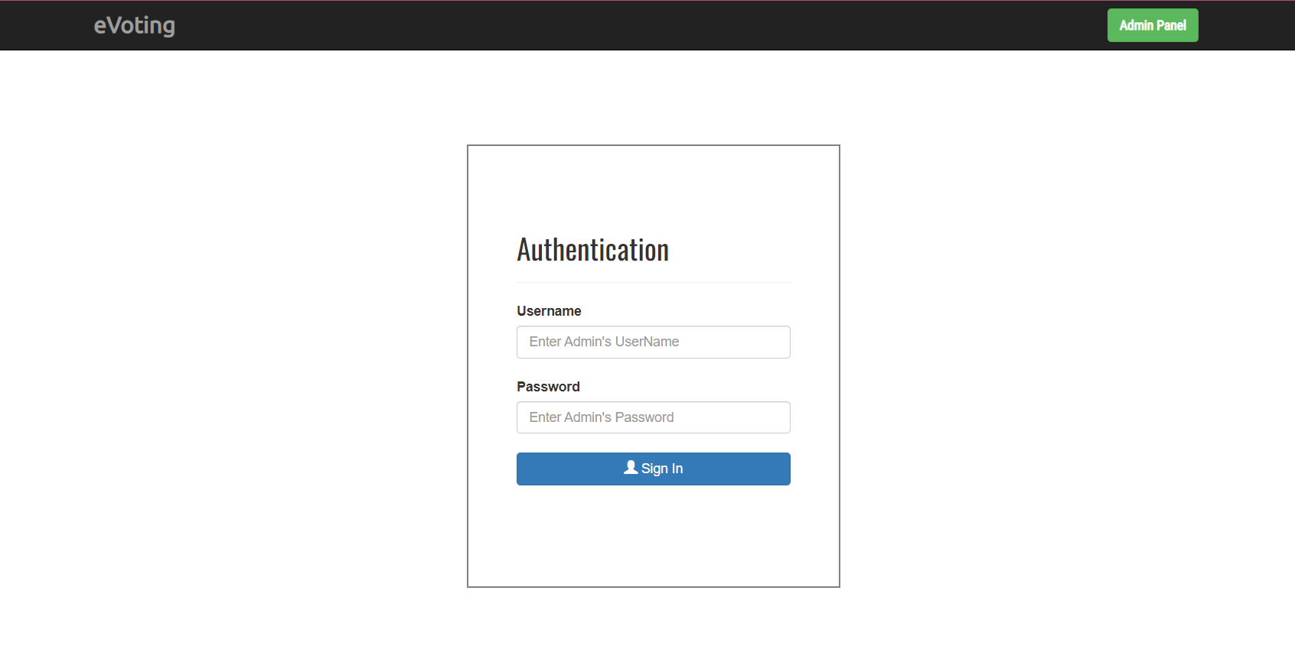
ADMIn LOGIN

Slide 12
CONCLUSION
This online voting system will manage the voter’s information by which voters can login and use his voting rights. The system will incorporate all features of Voting system. It provides the tools for maintaining voters vote to every party and it count total no. of votes of every party. By online voting system percentage of voting is increases. it decreases the cost and time of voting process.
Feedback from the mentor:
Voter registration.
Nominee registration.
Add new nominee and Remove nominee in list.
Feedback not updated.

Slide 13


